Slide 1


What’s New 2025
Virginia’s Sentencing Guidelines

Slide 2

Effective July 1, 2025
Changes to Virginia’s Sentencing Guidelines*
1
Three new offenses added to the guidelines for anyone sentenced on or after July 1, 2025
2
New Guidelines to cover all Robbery offenses with a new layout
3
Post-Release Supervision vs. Post-Release Probation
4
Definitions of Victim Injury and Legal Restraint
*Detailed information on each offense follows this summary slide.

Slide 3
1
Three offenses have been added to the guidelines for anyone sentenced on or after July 1, 2025

Slide 4
Three offenses added to the guidelines for anyone sentenced on or after July 1, 2025
1. Resist Arrest/Obstruct Justice (as defined by § 18.2-460(C) and VCC JUS-4832-F5) has been added to the Miscellaneous/Property Worksheets.
2. Unlawfully Shoot or Throw Missile at Train, Car, Etc. (as defined by § 18.2-154 and VCC VAN-2940-F6) have been added to the Miscellaneous Person/Property Worksheets.
3. Prisoner Possess, Sell, or Secrete an Unlawful Chemical Substance (as defined by § 53.1-203(5) and VCC PRI-3260-F6) has been added to the Miscellaneous/Other Worksheets.

Slide 5
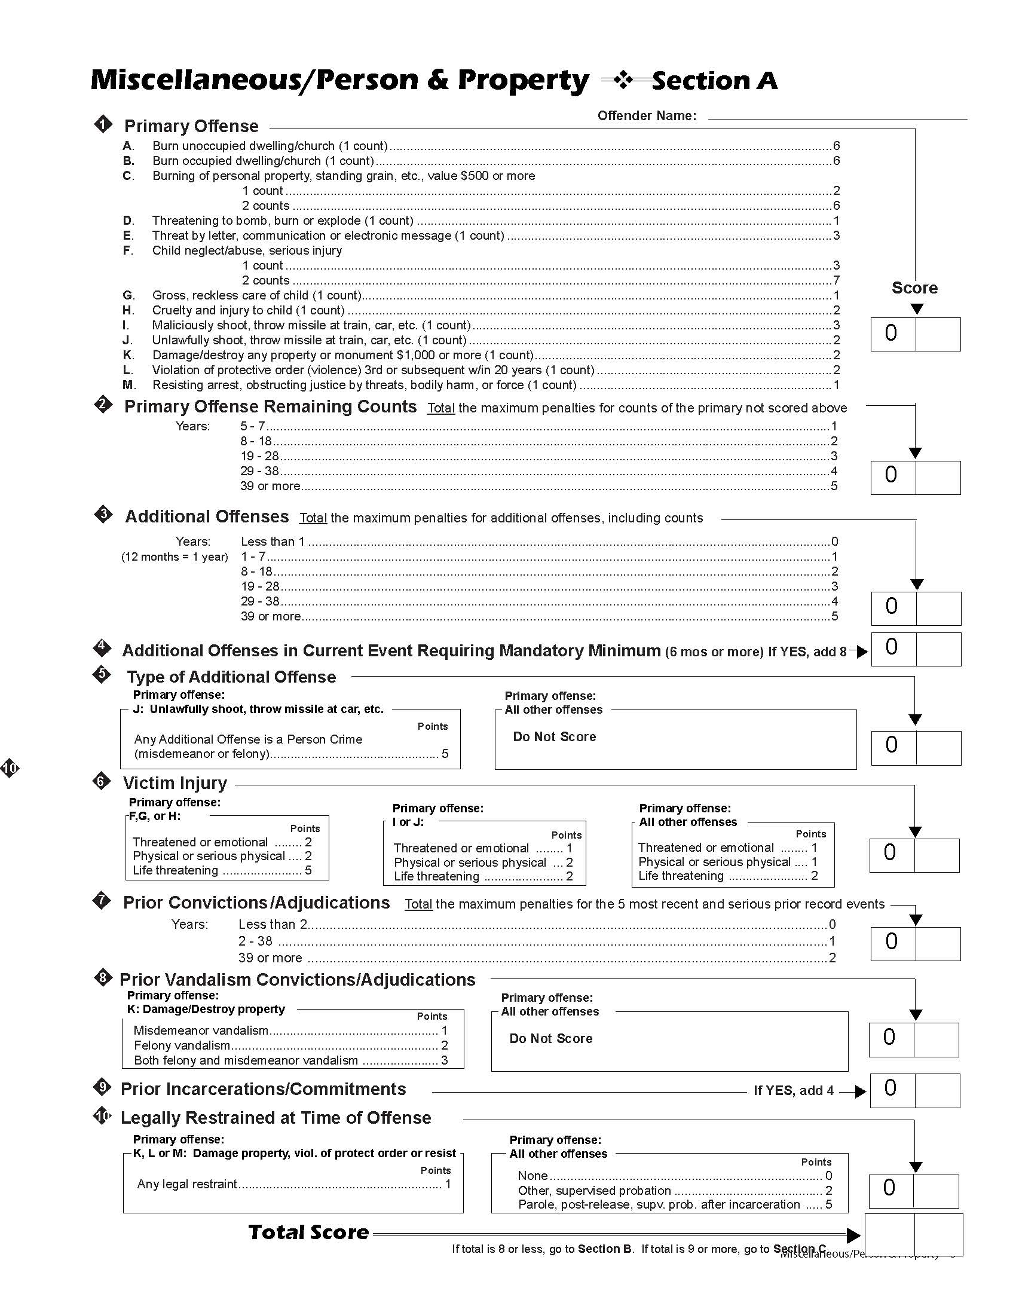
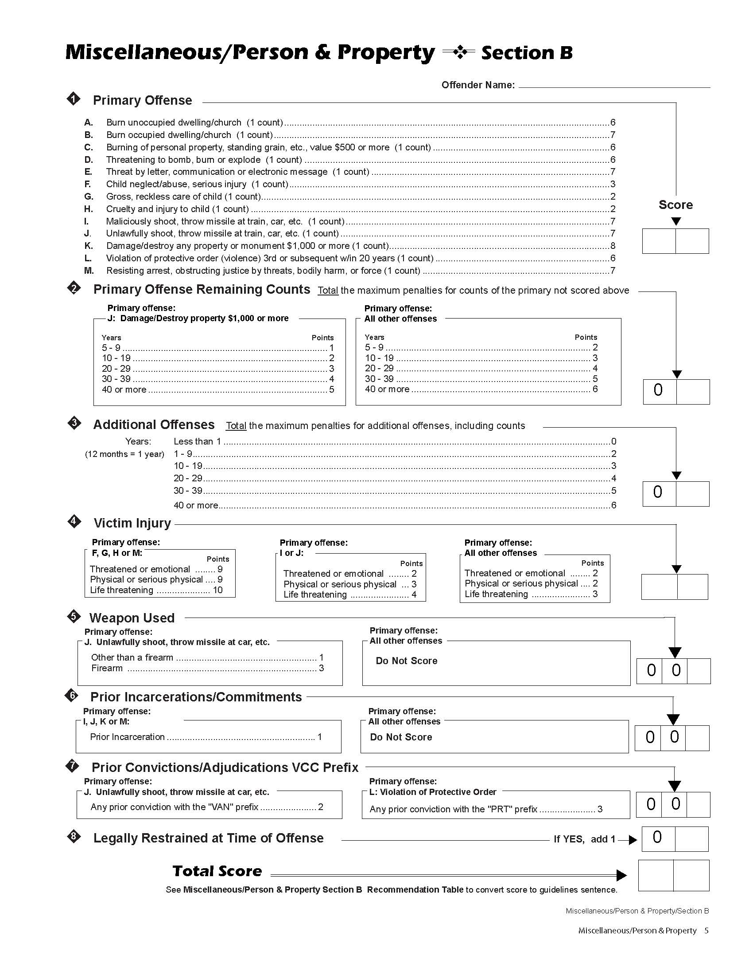
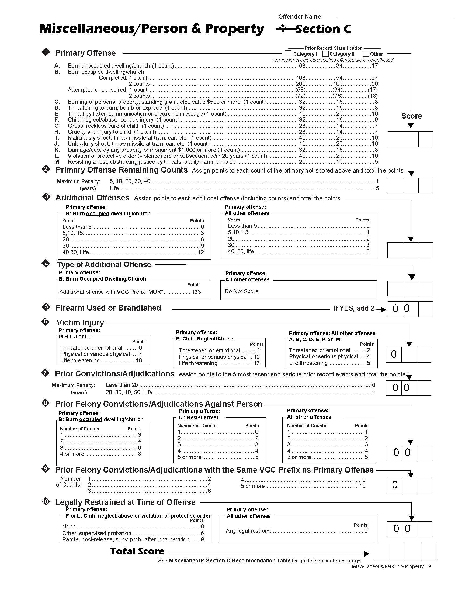
Three offenses added to the guidelines for anyone sentenced on or after July 1, 2025
1. Resist Arrest/Obstruct Justice by Threats or Force (as defined by § 18.2-460(C) and VCC JUS-4832-F5) has been added to the Miscellaneous/Person and Property Worksheets.
Worksheet A
Worksheet B
Worksheet C

Slide 6
Three offenses added to the guidelines for anyone sentenced on or after July 1, 2025
2. Unlawfully Shoot or Throw Missile at Train, Car, Etc. (as defined by § 18.2-154 (C,4) and VCC VAN-2940-F6) have been added to the Miscellaneous/Person and Property Worksheets.
Worksheet A
Worksheet B
Worksheet C

Slide 7
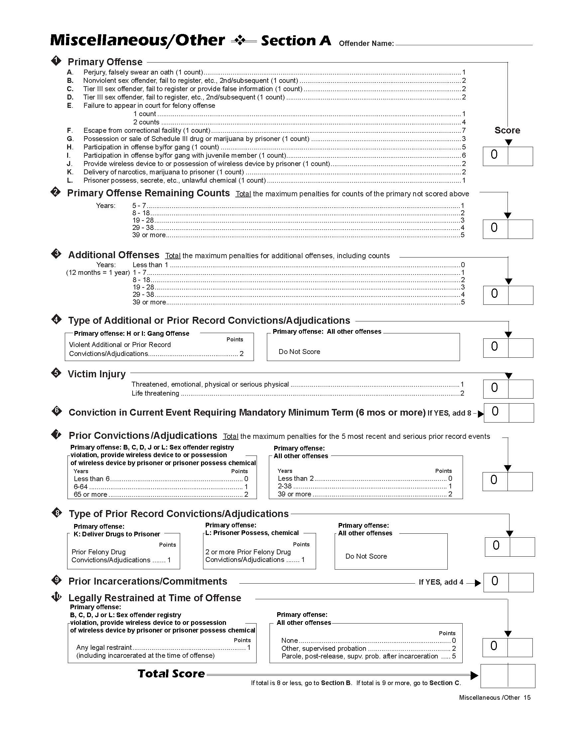
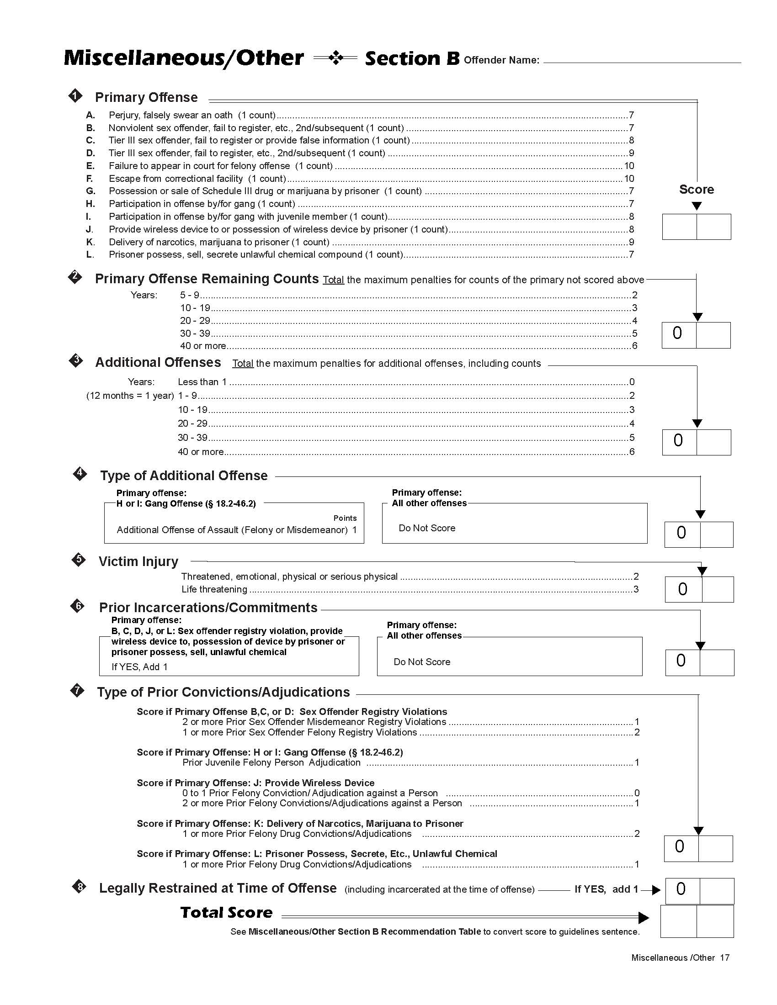
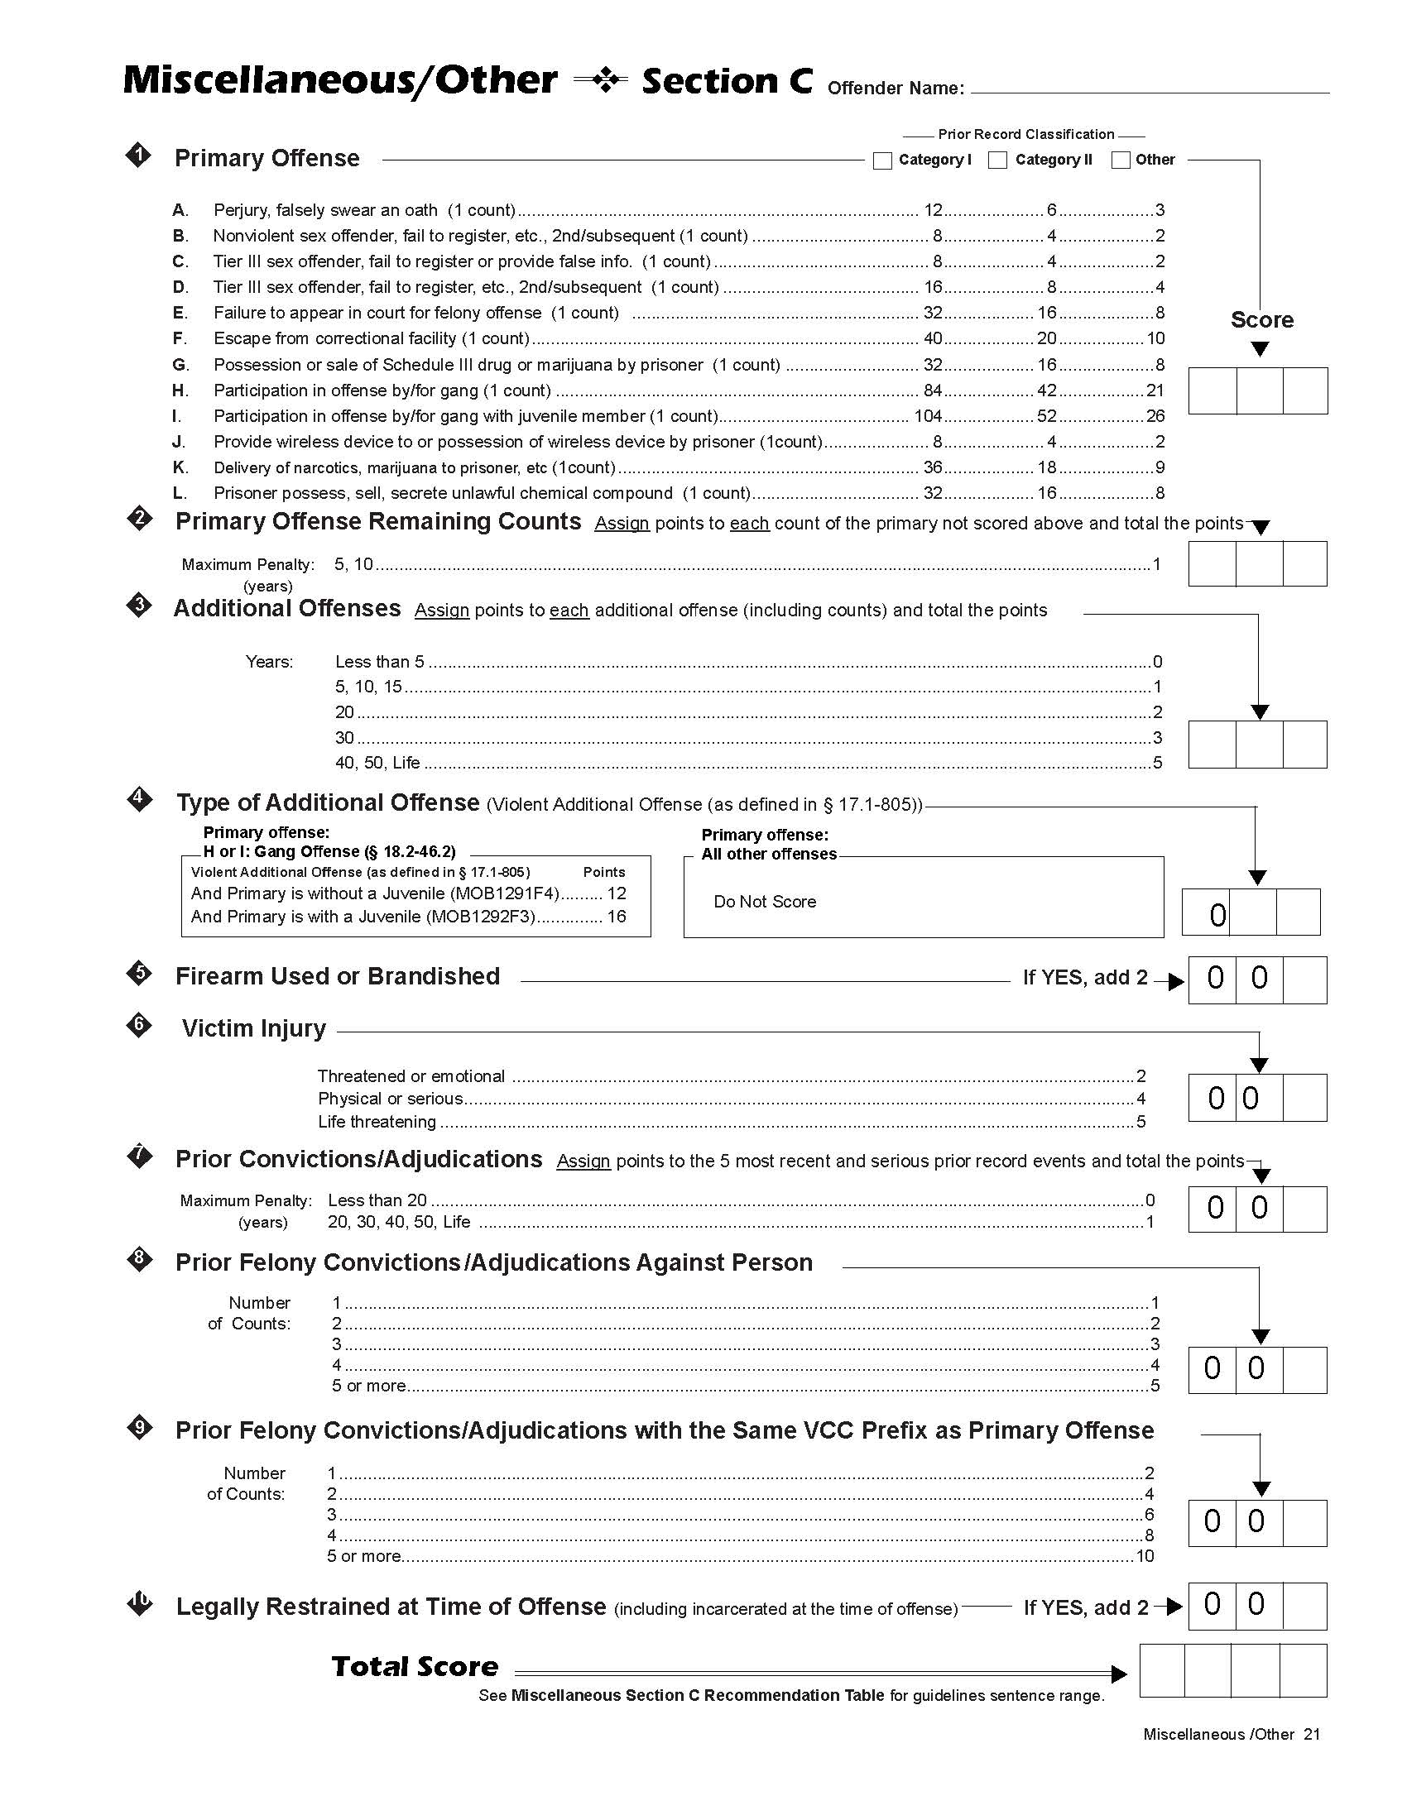
Three offenses added to the guidelines for anyone sentenced on or after July 1, 2025
3. Prisoner Possess, Sell, or Secrete an Unlawful Chemical (as defined by § 53.1-203(5) and VCC PRI-3260-F6) has been added to the Miscellaneous/Other Worksheets.
Worksheet A
Worksheet B
Worksheet C

Slide 8
New Guidelines to cover all Robbery offenses with a new layout
2

Slide 9
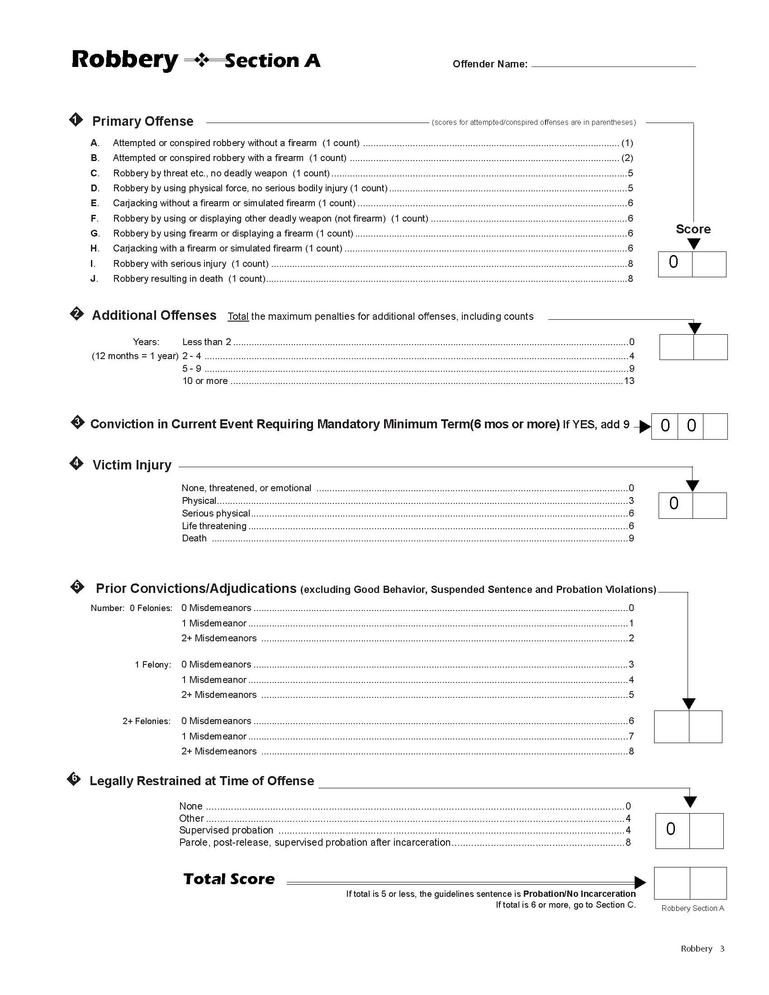

New Robbery Guidelines
The new Robbery Guidelines are based on a comprehensive analysis of available sentencing data in cases where Robbery or Carjacking was the primary offense. The recommended dispositions are designed to closely match the historical rate of incarceration.
The new Robbery worksheets remain a bifurcated system. Worksheet A is used to determine if the recommendation is probation/no incarceration or incarceration of 1 day or more.
Notes:
This slide should contain images of both worksheets (Burglary/Dwelling & Other) Recommendation Tables from previous year and one from the current

Slide 10
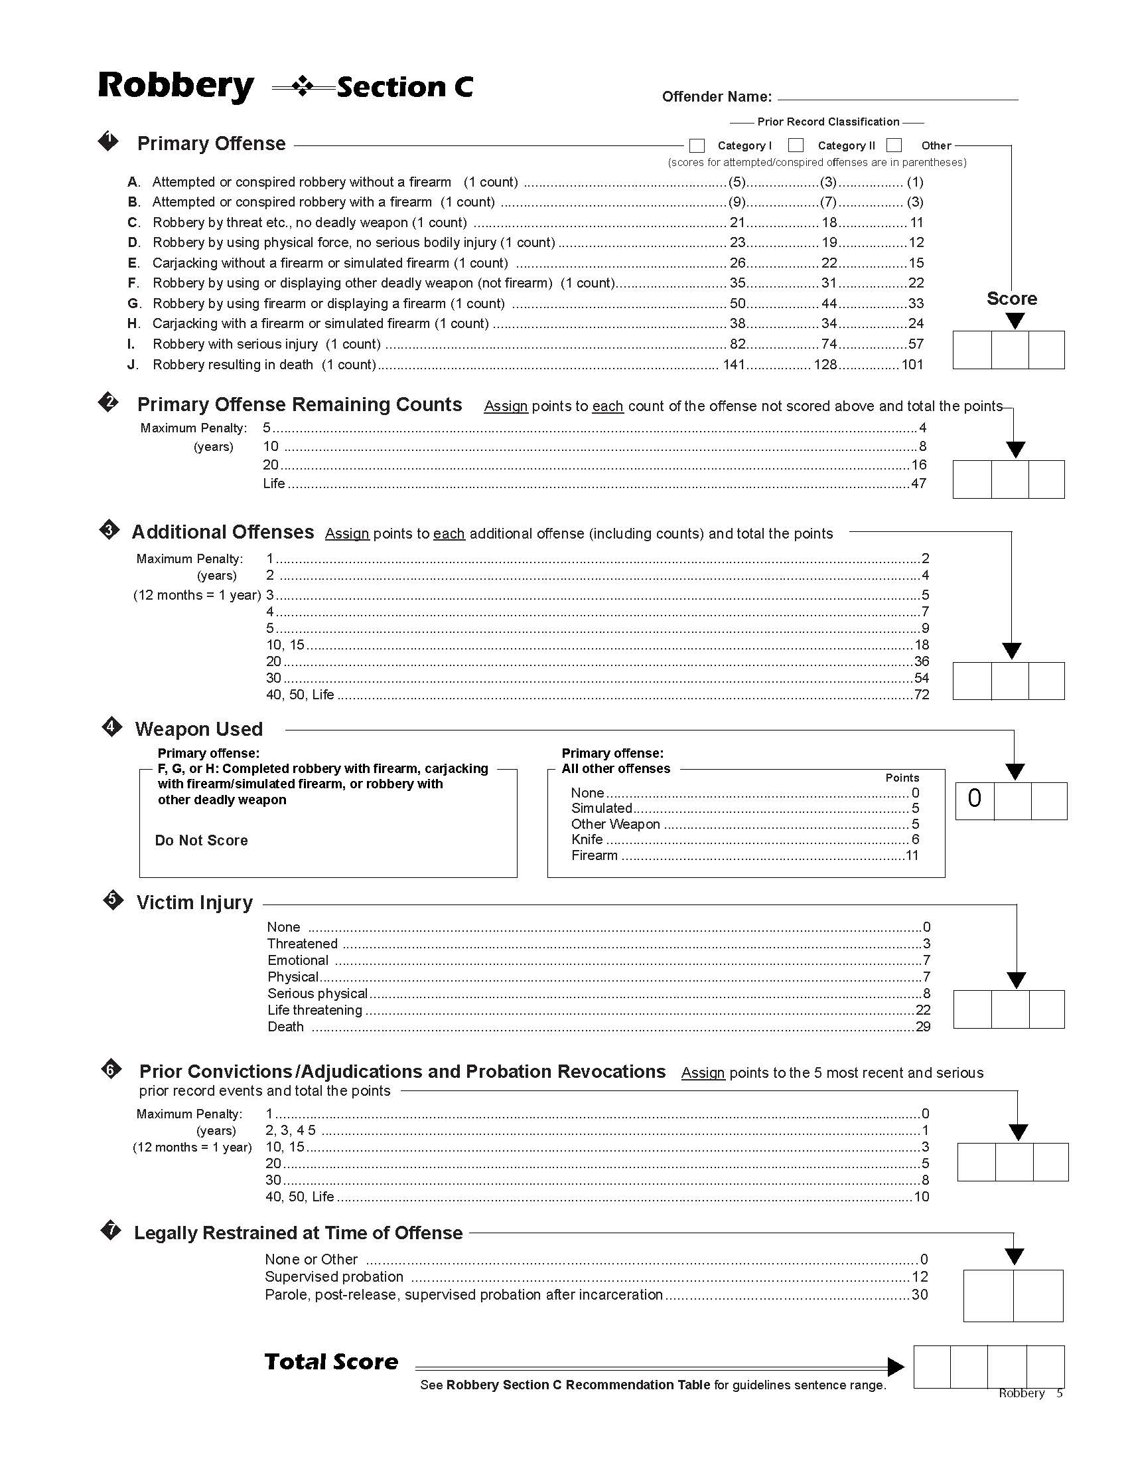
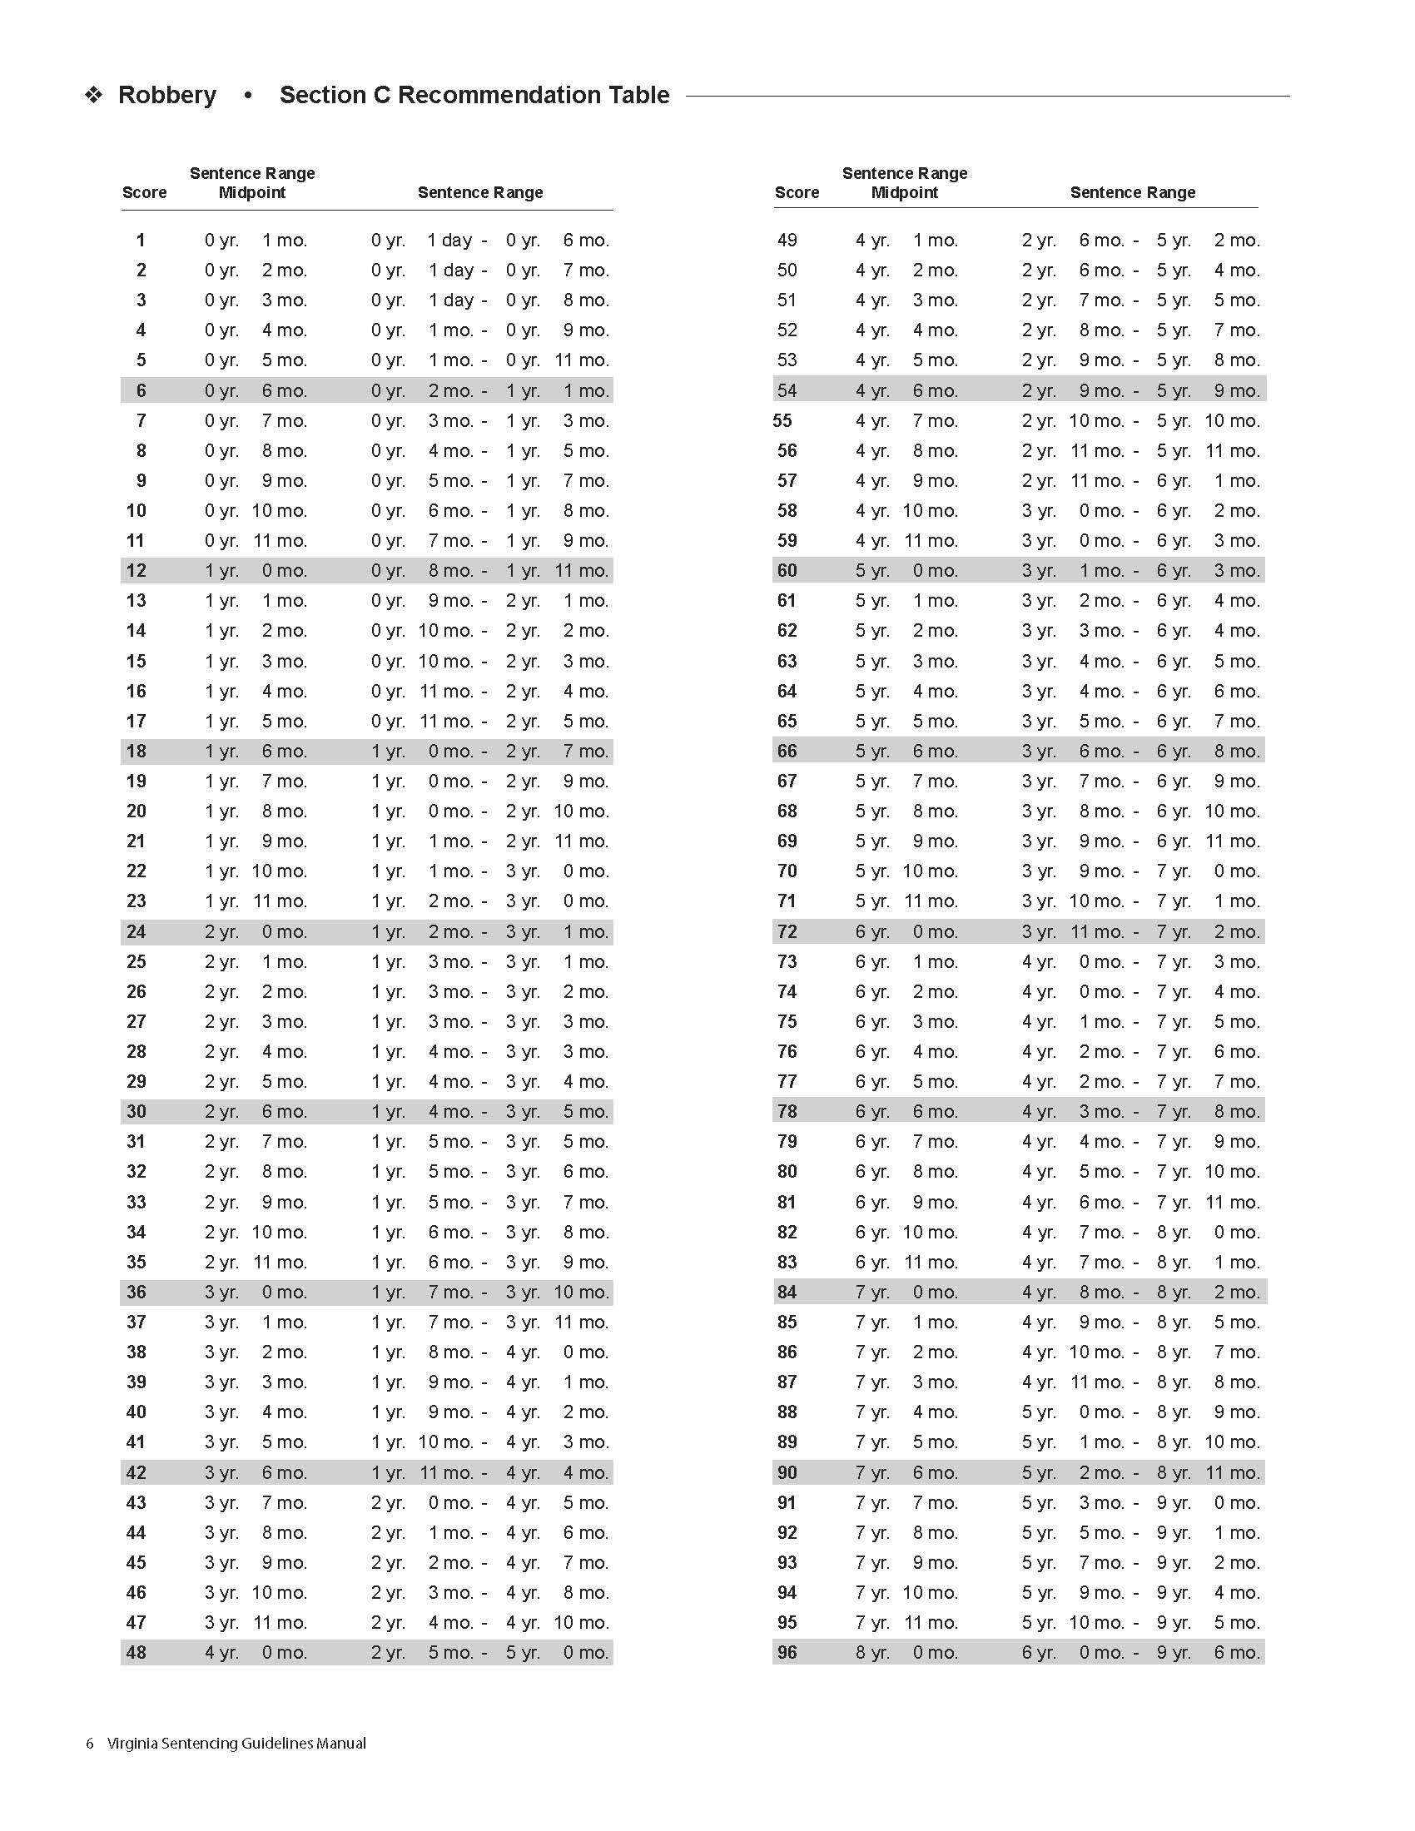
New Robbery Guidelines
There is no worksheet B for Robbery.
For the first time, Worksheet C will determine a jail or prison sentence.
The Robbery recommendation table has been adjusted to reflect recommendations for a jail sentence.

Slide 11
New Robbery Guidelines
Carjacking scores have been adjusted to reflect current historical sentencing patterns.

Slide 12
New Robbery Guidelines
Remember to submit new Robbery guidelines
if a sentencing hearing for Robbery was continued until July 1, 2025, or later.

Slide 13
New Robbery Guidelines
The new Robbery guidelines will only apply to offenses that occurred July 1, 2021, or after,
and sentenced July 1, 2025, and after.
Carjacking offenses are covered regardless of offense date.
The revised guidelines apply to sentencing events July 1, 2025, or after.

Slide 14
3
Post-Release Supervision vs. Post Release Probation

Slide 15
Post-Release Supervision vs. Post Release Probation
§ 19.2-295.2 has been amended to change Post-Release Supervision to Post-Release Probation. Failure to successfully complete the period of probation in accordance with this section shall be subject to revocation of such probation pursuant to §§ 19.2-306 and 19.2-306.1.

Slide 16
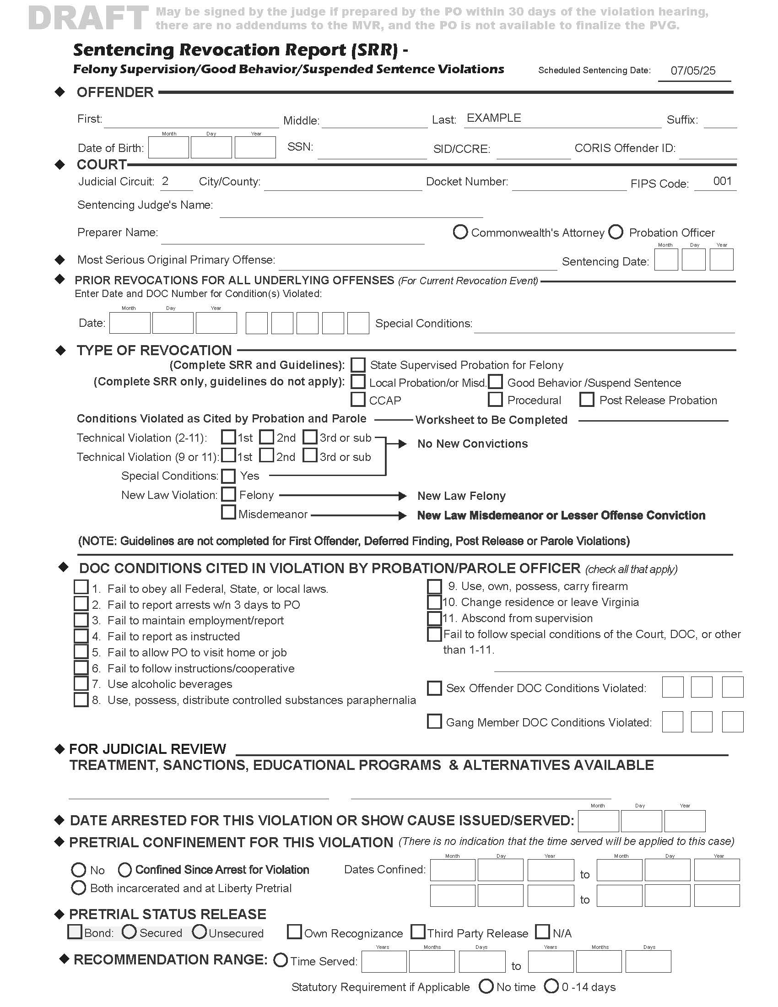
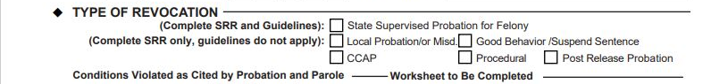
Post-Release Supervision vs. Post Release Probation

Slide 17
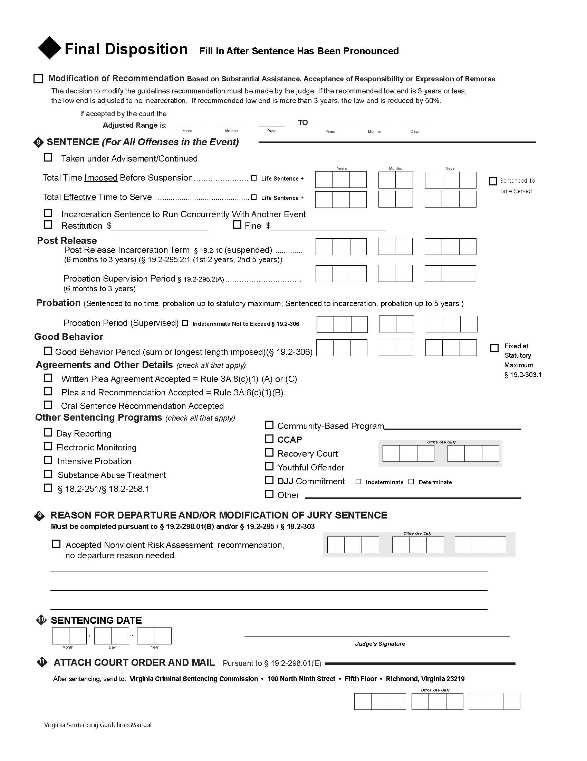
Post Release Incarceration did not change for § 19.2-295.2:1.
  First violation of § 18.2-472.1 = 2 years
  Second violation of § 18.2-472.1 = 5 years
Post Incarceration Period now labeled Probation Supervision Period to reflect the revised statute.

Slide 18
4
Definitions of Victim Injury and Legal Restraint

Slide 19
Definition of Victim Injury
There are now five types of Victim Injury
Threatened
Emotional
Physical
Serious Physical
Life Threatening

Slide 20
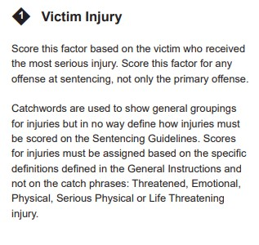
Definition of Victim Injury
Victim injury is defined in the manual on page 24 using catchwords to identify levels of injury.
Users must score this factor based on the definitions, not the catchwords.
The definitions are not repeated in each offense section; instead, each section will have a reference back to the definitions page.

Slide 21
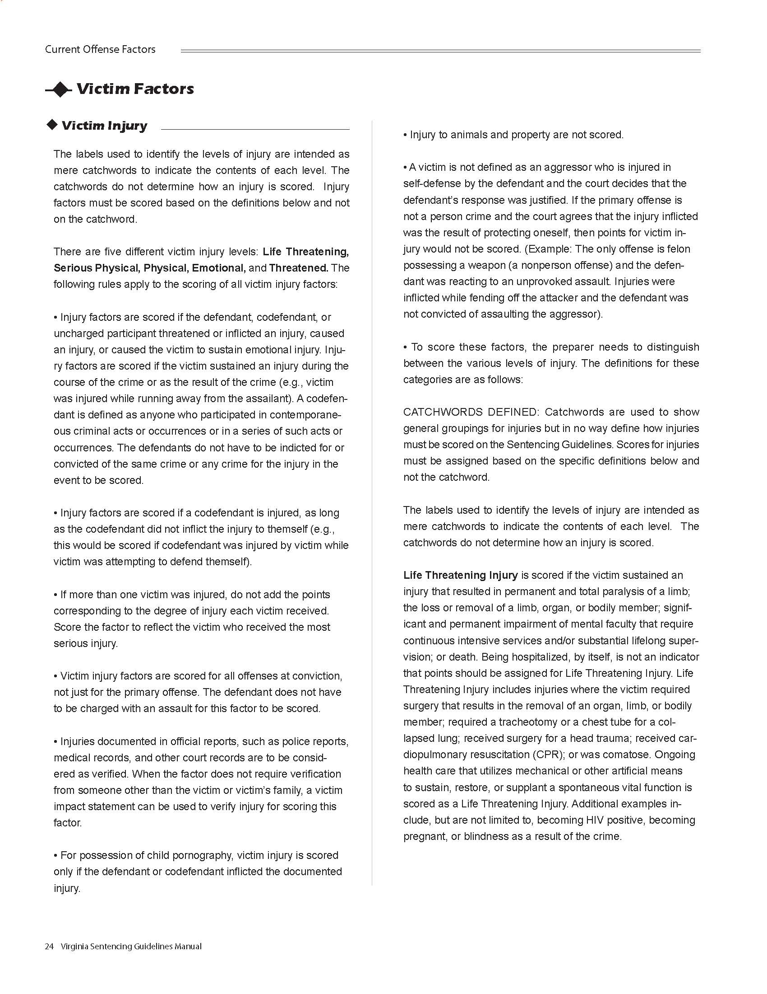
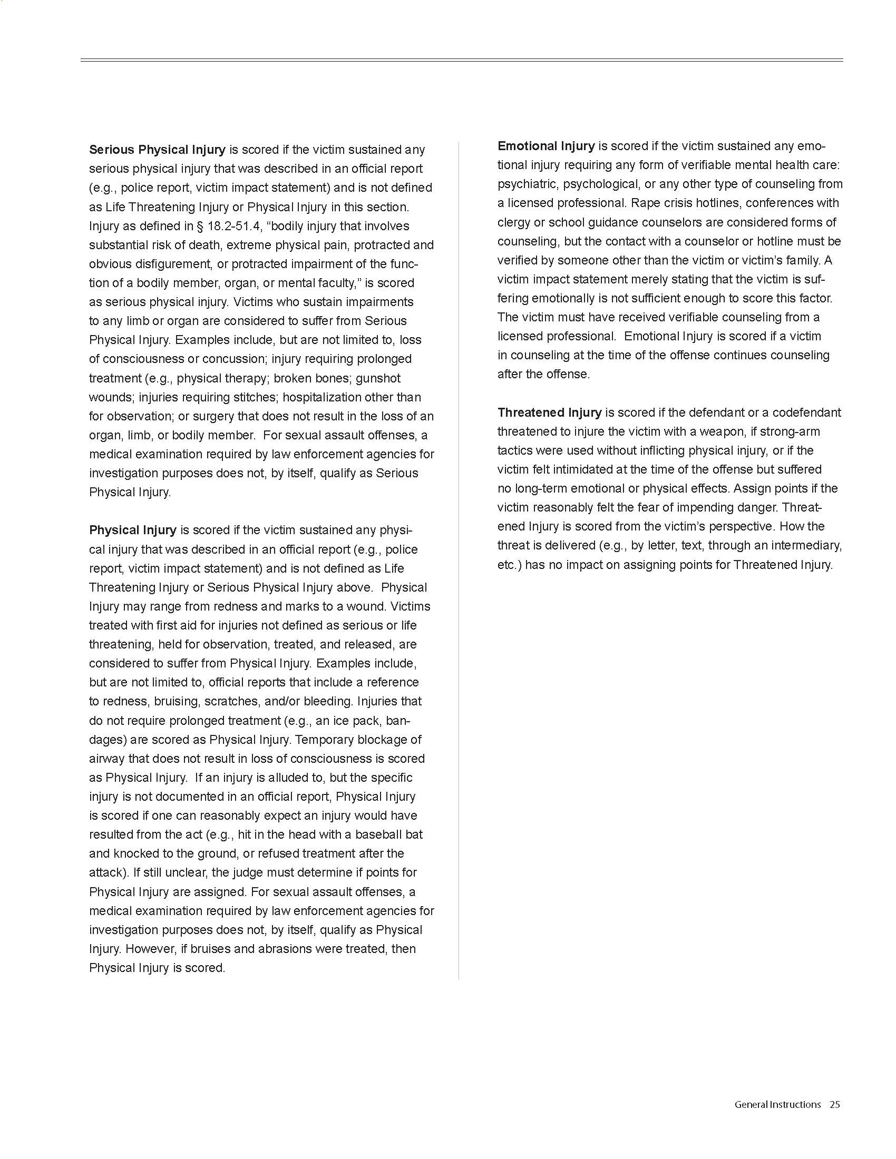
Definition of Victim Injury

Slide 22
Definition of Victim Injury
Catchword
Threatened
Victim senses impending danger
Victim feels intimidated
Scored from victim’s viewpoint

Slide 23
Definition of Victim Injury
Catchword
Emotional
Victim received mental health care by licensed professional
Verified by someone other than a family member

Slide 24
Definition of Victim Injury
Catchword
Physical
No prolonged treatment required
Treated with First Aid
Held for observation

Slide 25
Definition of Victim Injury
Catchword
Serious Physical
Injury defined in § 18.2-51.4
Requires prolonged treatment
Impairment of an organ or limb
Extreme physical pain

Slide 26
Definition of Victim Injury
Catchword
Life Threatening
Loss or permanent and total paralysis of a limb
Loss of an organ
Ongoing care utilizing mechanical or other artificial means
Death

Slide 27
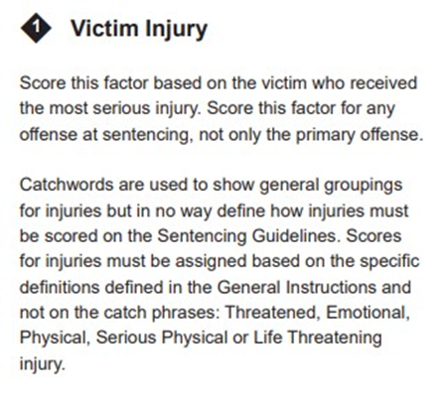
Definition of Victim Injury

Slide 28
4
Definitions of Victim Injury and Legal Restraint

Slide 29
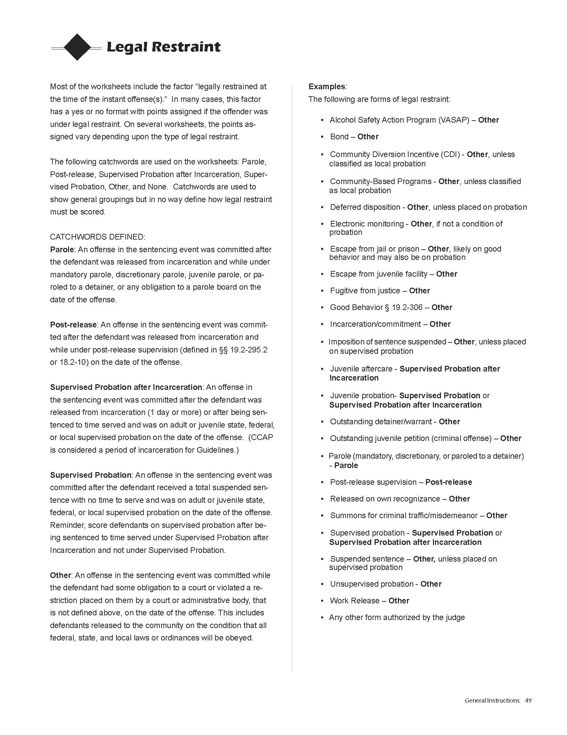
Definition of Legal Restraint
New verbiage added for the legal restraint factor.
Legal restraint is defined in the manual on page 49 using catchwords to identify types of restraint. Users must score this factor based on the definitions, not the catchwords. The revised manual provides extensive examples of legal restraint and how to score them correctly.

Slide 30
Definition of Legal Restraint
As of July 1, 2025, Post-Release will be scored the same as Supervised Probation after Incarceration.
* The manual and Worksheets were printed prior to the legislation being signed.

Slide 31
A few important reminders:

Slide 32
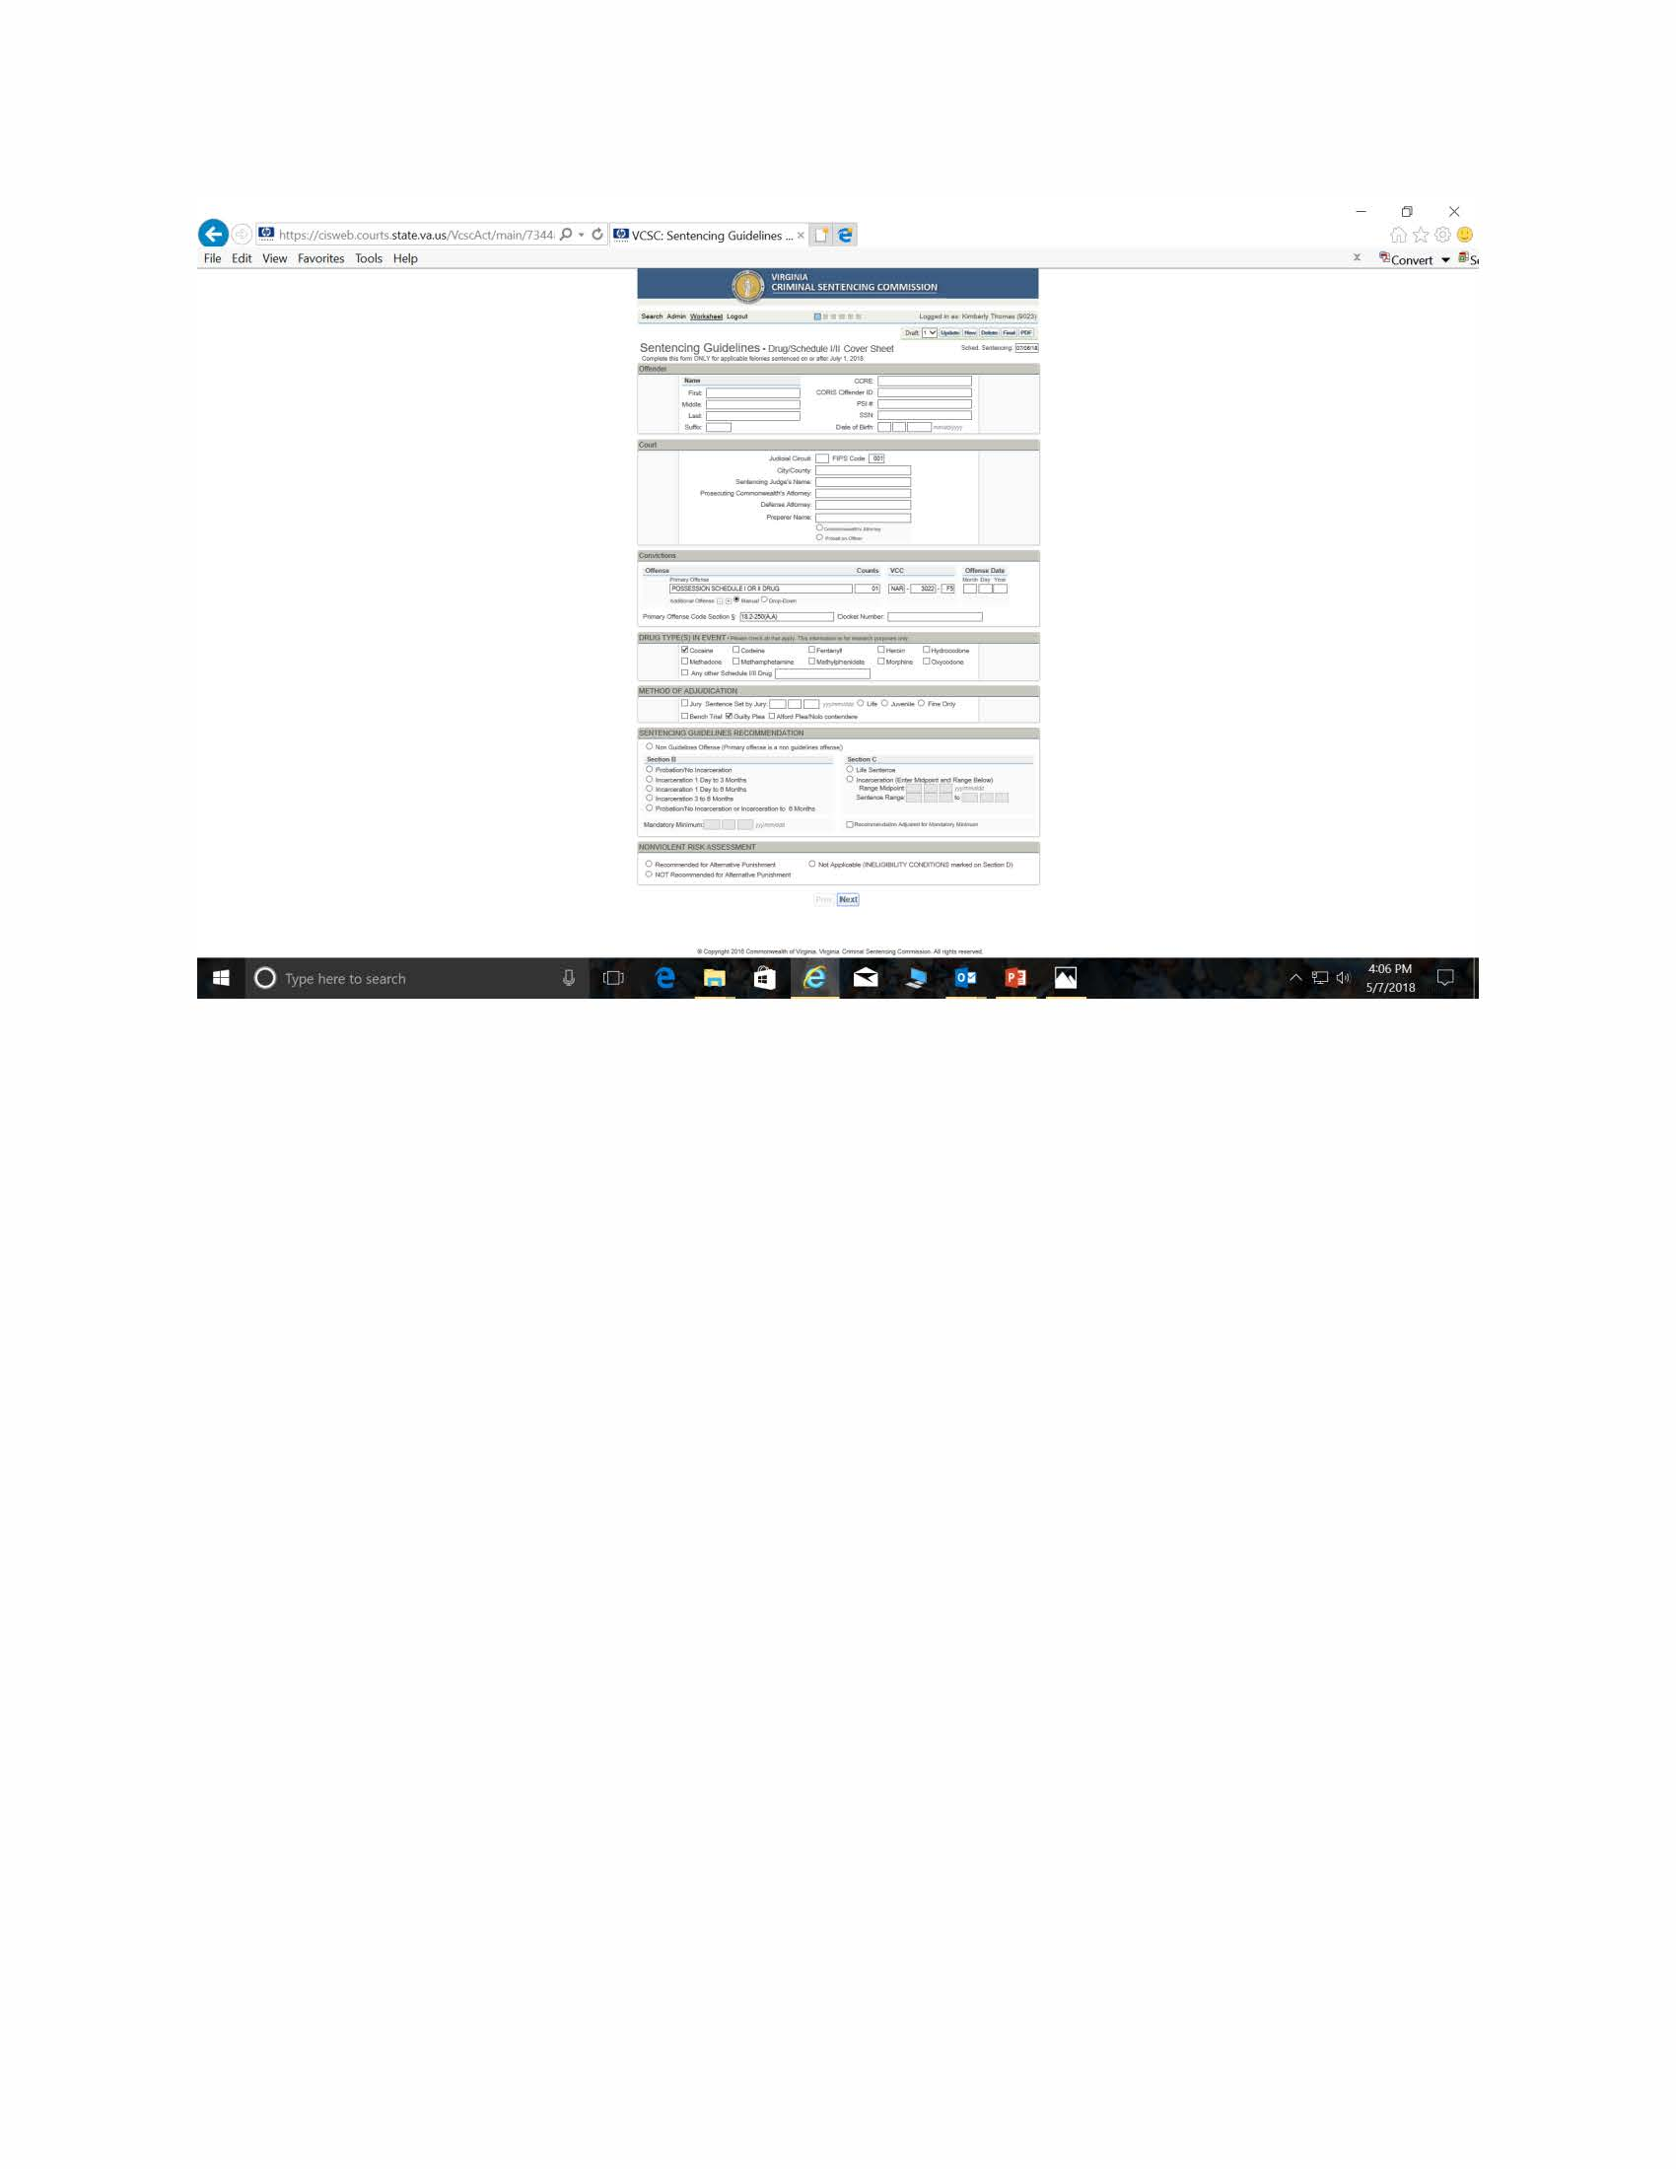
Per § 19.2-298.01(E) Sentencing Guidelines must be submitted for every felony sentencing event, including cases that will result in deferred findings.

Slide 33
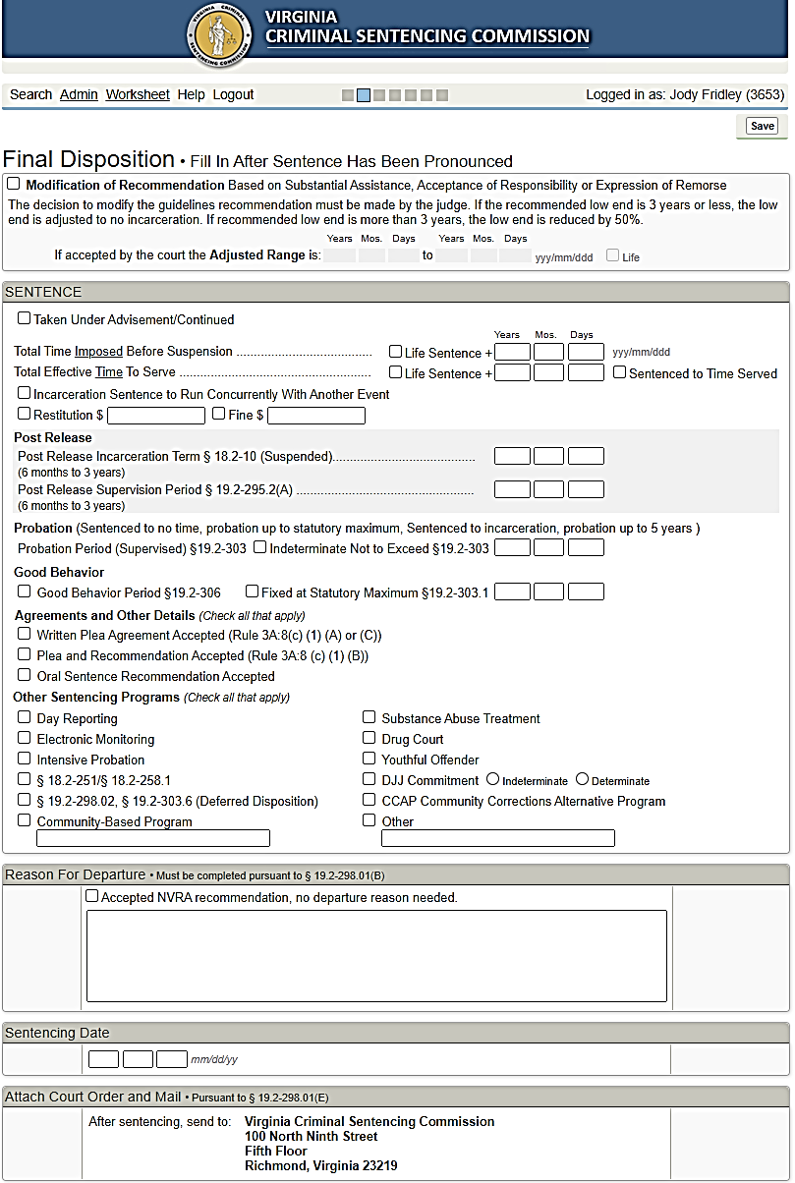
In deferred cases, the judge would check:
Taken Under Advisements &
Other Sentencing Programs

Slide 34
Deferred Findings
In cases where the defendant has violated the conditions of the deferred findings, guidelines must be submitted to the court.
In those cases, you can clone the original guidelines submitted to the court, update them if needed, and change the “F” to a “D” for each felony offense.

Slide 35
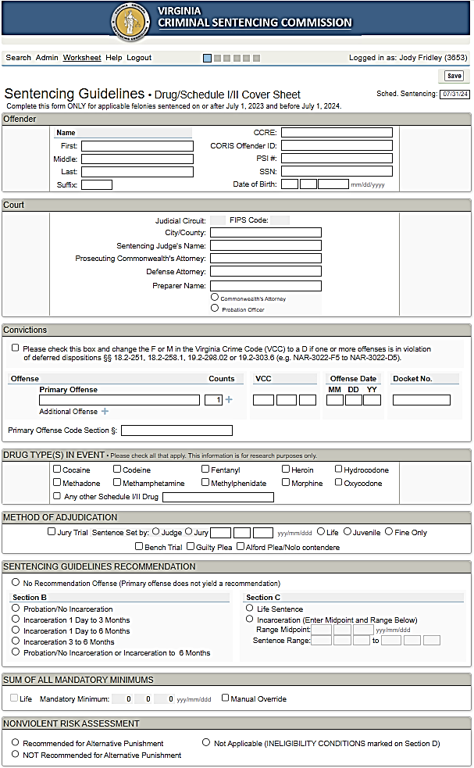
NAR 3022 D5

Slide 36

Probation Violation Guidelines
When you receive a hit notice that the defendant has been arrested on a probation violation capias complete the Probation Violation guidelines and finalize them using the correct docket number. This will place the guidelines on the judge’s docket.
Make sure that the name and docket number matches what is in the court’s file so the guidelines will appear on the judge’s docket.
Use the docket number for the revocation and not the underlying offense(s).

Slide 37
The Official Guidelines must be completed using SWIFT!
The Sentencing Worksheet Interactive File Transfer (SWIFT!) is a web-based application designed for automating the sentencing guidelines, and is the source for Official Worksheets. The application will allow users to complete the guidelines forms online, give users the ability to save guidelines information and recall it later. In the future, SWIFT! will provide a way for users to submit the guidelines to the court electronically, and permit the Clerks to send the guidelines forms to the Commission in electronic format.
Obtain your free and private account by sending an email to: SWIFT@vcsc.virginia.gov.
  Include your name,
  email address
  bar number, and the
  name of your primary court.
Guidelines should be finalized in SWIFT! prior to being submitted to the court.

Slide 38
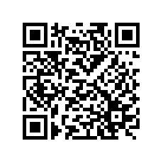
Visit the Commission’s mobile site by texting VCSC to 804-656-5111, or scanning the QR code.
• Learn about the 2025 changes
• Register for seminars
• Search for Virginia Crime Codes by statute or key word
• Quick reference to common rules
• Register for limited text alerts on changes
• View or download worksheets
• Access to the mobile guidelines manual and ranges
Go to http://bycell.co/cgac or mobile.vcsc.virginia.gov
on your mobile device
Or dial 804-200-4941 on your mobile phone
to receive a text message and click on the link
Message & Data Rates May Apply. You can unsubscribe at any time by texting STOP to 804.656.5111. Text HELP to 804.656.5111 for help or contact VCSC at 804.225.4398.

Slide 39

Information
Contact staff of the Commission by phone from 7:30AM to 5:00PM (Monday – Friday) 804.225.4398
Contact staff of the Commission by text at 804.393-9588
Text VCSC to 804.656.5111 for the mobile web site.
Contact Staff by Email. Email addresses are posted on the Commission’s website: www.vcsc.virginia.gov.
Manuals, VCC Books and updates will be shipped in late June.
  An order form for the 28th edition of Virginia’s Sentencing Guidelines Manual is available on the Commission’s website.
  Judges, Commonwealth’s Attorneys, Public Defenders and Probation Officers will automatically be shipped updates based on the number requested last year.

Slide 40
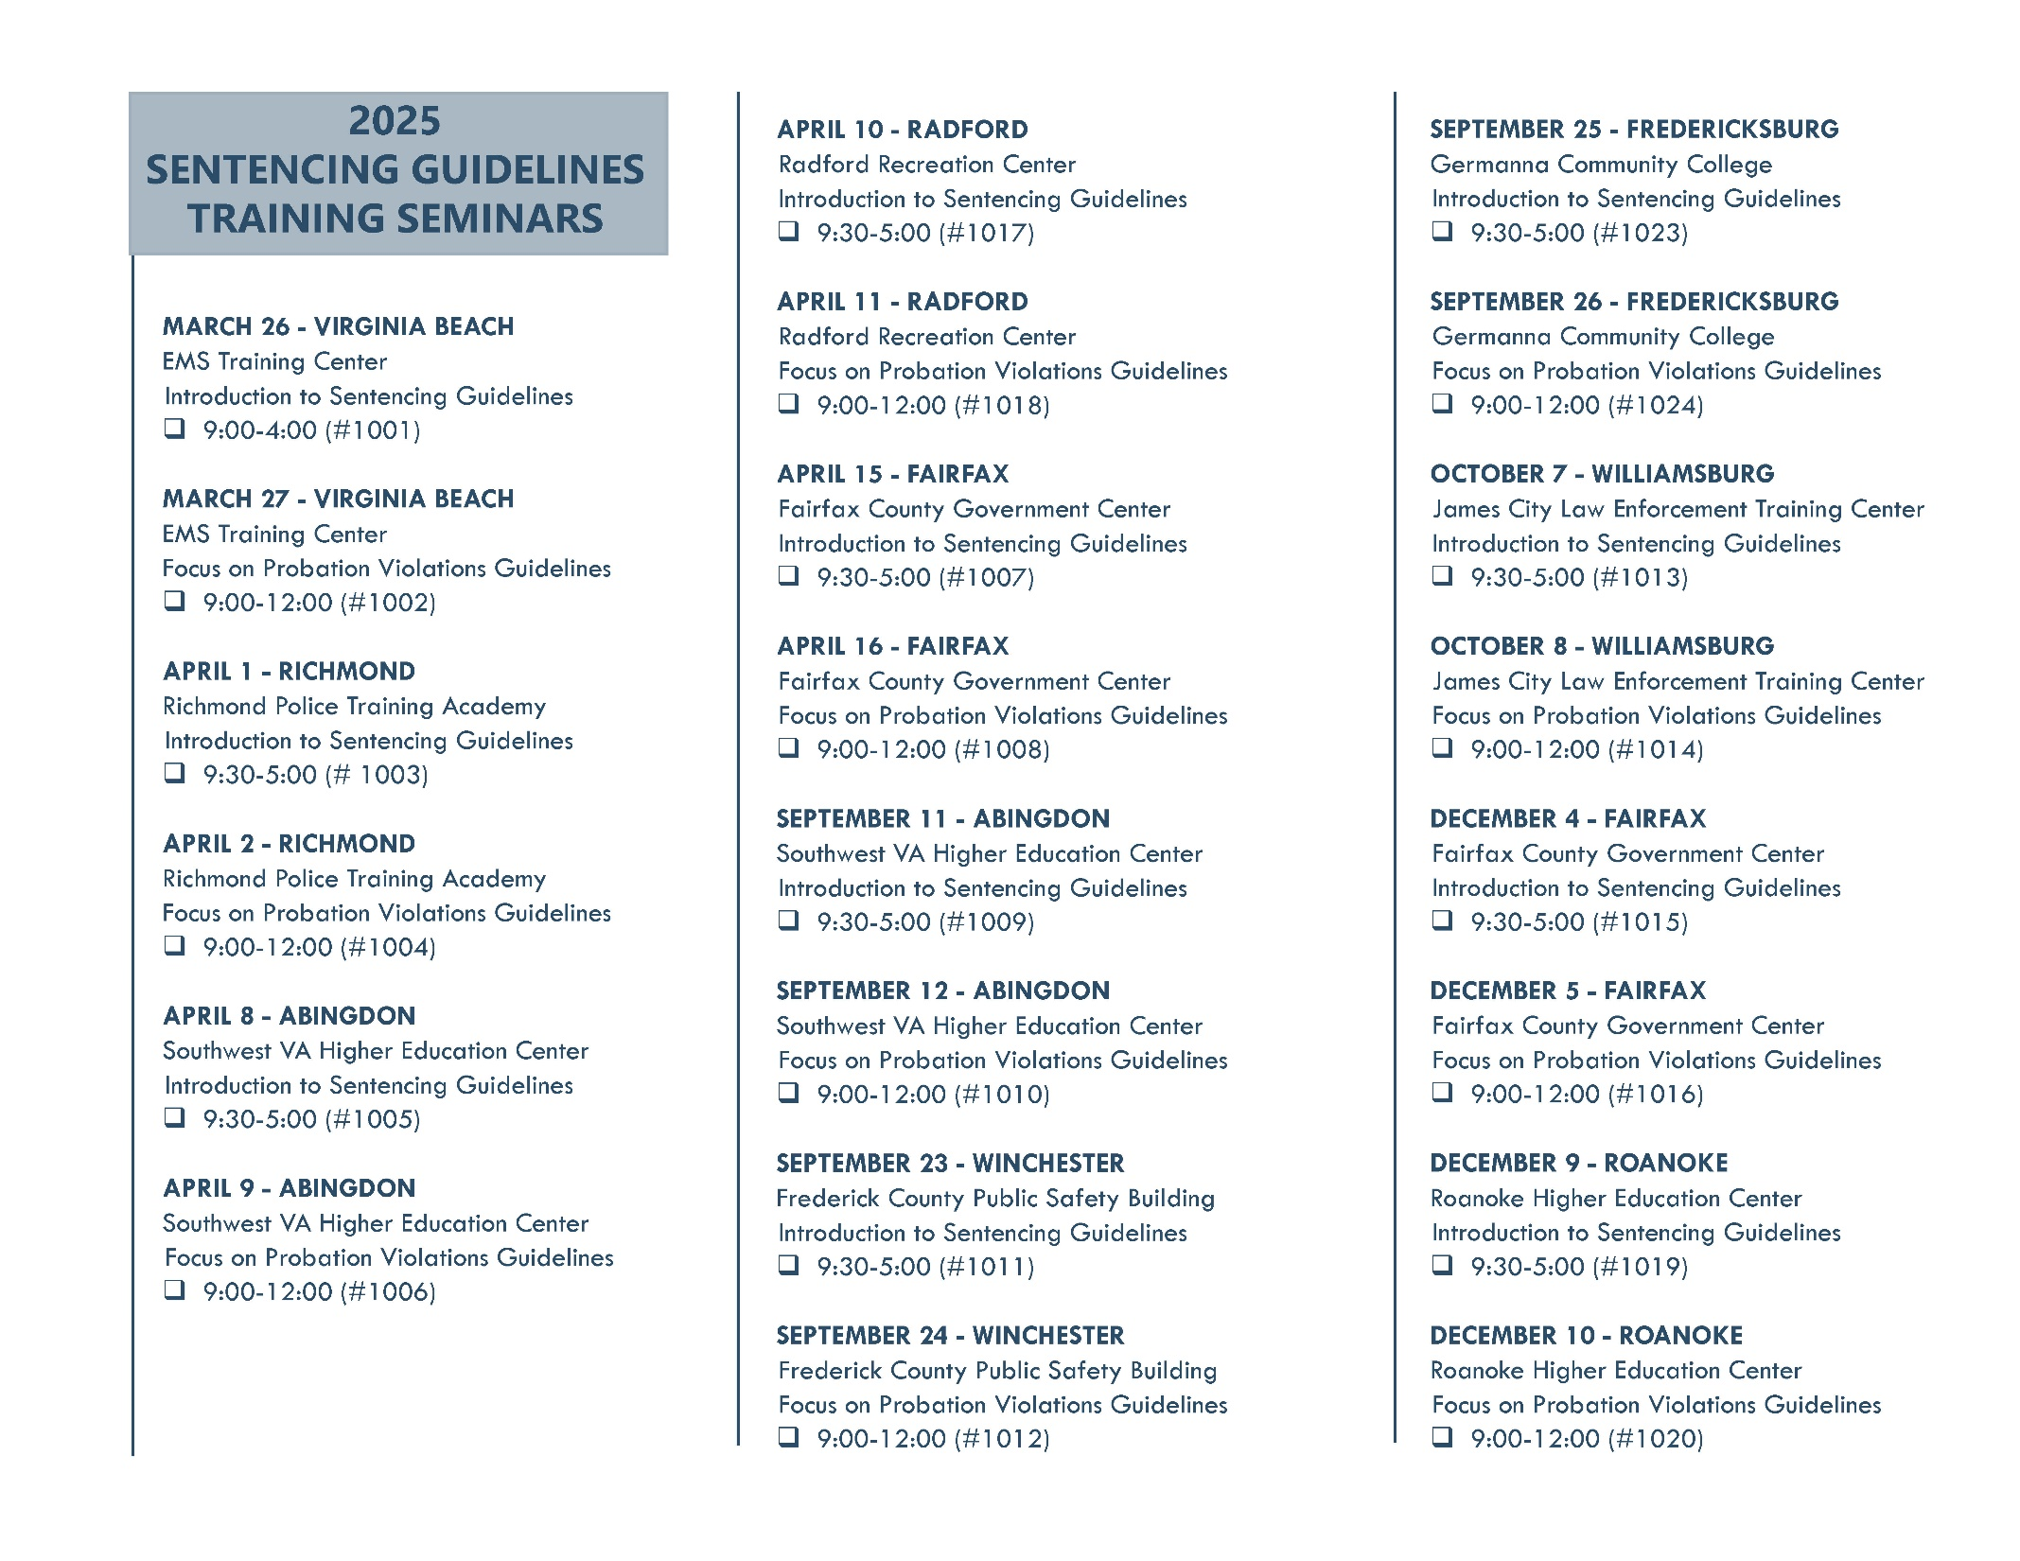
Notes:
May want to change the wording, but we could address that we are exploring other training options and will possibly release a new schedule in the near future (or you can get as specific as you wish)

Slide 41
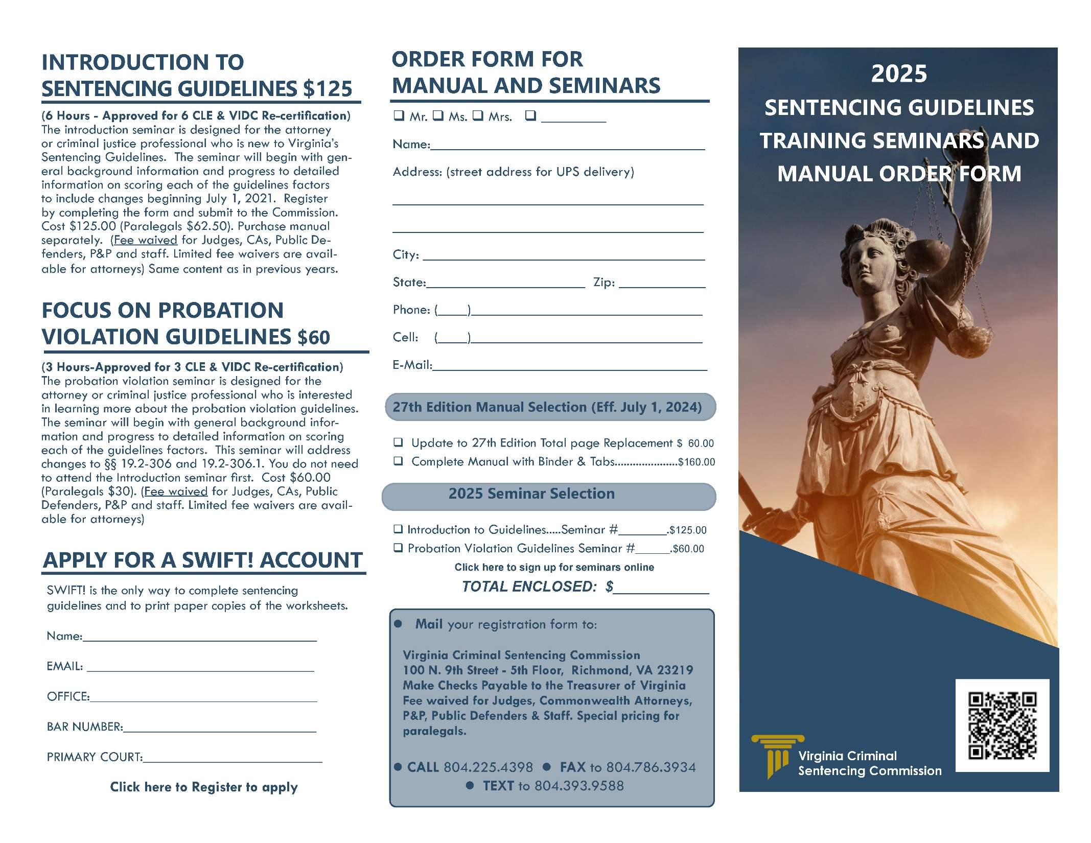
Notes:
May want to change the wording, but we could address that we are exploring other training options and will possibly release a new schedule in the near future (or you can get as specific as you wish)

Slide 42


Virginia Criminal
Sentencing Commission
100 North Ninth Street
Richmond, VA 23219
Supreme Court Building
5th Floor
804-225-4398
www.vcsc.virginia.gov

